Slide 1
“The Canon of Scripture”
THE CASE FOR A RECOGNIZED CANON IN THE FIRST CENTURY

Slide 2
Mistaken Ideas of Canon
There are lost books that should be in the Bible
The books of inspiration were agreed on by a council of uninspired men
The Books were compiled As authoritative hundreds of years after the original writers died
Certain books in the New Testament were written by frauds

Slide 3
What Does Canon Mean?
“Sphere”
“We, however, will not boast beyond measure, but within the limits of the SPHERE which God appointed us—a sphere which especially includes you” (2 Cor. 10:13)
“Rule”
“And as many as walk according to this RULE, peace and mercy be upon them, and upon the Israel of God” (Gal. 6:16)

Slide 4
2 Timothy 3:15-17
15 and that from childhood you have known the Holy Scriptures, which are able to make you wise for salvation through faith which is in Christ Jesus.
16 All Scripture is given by inspiration of God, and is profitable for doctrine, for reproof, for correction, for instruction in righteousness,
17 that the man of God may be complete, thoroughly equipped for every good work.

Slide 5
The Rule to Authority
The Death and Resurrection of Jesus
Verifies Old Testament canonicity (Lk. 24:44, 45)
Verifies New Testament canonicity (Lk. 24:46-49)
The Holy Spirit in the revelation of Scripture (Jn. 16:7-15)

Slide 6
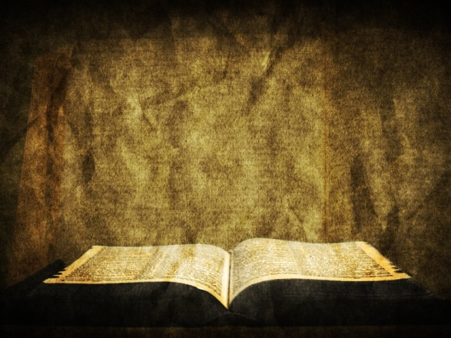
Revelation
FATHER
SON
HOLY SPIRIT
APOSTLES
BIBLE
John 5:19, 30; 14:24
John 16:13
1 Cor. 14:37
1 Thess. 2:13 2 Thess. 2:15; 3:6, 14
Rev. 22:18, 19
Ephesians 3:1-5

Slide 7
N. T. Books → Scripture
2 Peter 3:15, 16
Given wisdom
Ex. 31:2, 3; Matt. 10:16-20; Lk. 12:11, 12; 21:12-15; 1 Cor. 2:13; 12:8
Written to the same people Peter wrote to
1 Pet. 1:1
Written epistles (plural)

Slide 8
N. T. Books → Scripture
2 Peter 3:15, 16
Epistles were known and accessible to Peter
Epistles were known and accessible to the people
Well read and circulated (cf. 1 Thess. 5:27; Col. 4:16)
in circulation for some time
Understood as Scripture

Slide 9
N. T. → Scripture
“For the Scripture says, ‘You shall not muzzle an ox while it treads out the grain,’ and, ‘The laborer is worthy of his wages.’”
Deuteronomy 25:4; 1 Corinthians 9:9
Luke 10:7
“For the Scripture says, ‘You shall not muzzle an ox while it treads out the grain,’ and, ‘The laborer is worthy of his wages.’”
Deuteronomy 25:4; 1 Corinthians 9:9
1 Timothy 5:18

Slide 10
A Fixed Canon in the First Century
6 I marvel that you are turning away so soon from Him who called you in the grace of Christ, to a different gospel,
7 which is not another; but there are some who trouble you and want to pervert the gospel of Christ.
8 But even if we, or an angel from heaven, preach any other gospel to you than what we have preached to you, let him be accursed.
9 As we have said before, so now I say again, if anyone preaches any other gospel to you than what you have received, let him be accursed.
Galatians 1:6-9

Slide 11
Death, Burial, and Resurrection of Jesus
Old Testament Prophecy
New Testament Apostles
Luke 24:44-49

